Slide 1
DISTRIBUTION LICENSE TRACKER
By Gopalakrishnan Kumar, MTech IIT-Bombay,
Freelance Data Science Consultant
LinkedIn: Profile Link : https://www.linkedin.com/in/gopalakrishnankumar-a73301110/
Github:https://github.com/Gopal21236/
Kaggle URL- https://www.kaggle.com/gopalkk2

Slide 2
Google Colab URL
https://colab.research.google.com/drive/1Clv7AWGLCDfS40VhSXGD-f60oZ6OJwOv?usp=sharing

Slide 3
Introduction
The mutual fund distribution industry is highly regulated, requiring distributors to maintain valid licenses and certifications at all times. Failure to comply with regulatory requirements such as timely renewal of licenses or completion of continuing education (CE) credits can lead to suspension of business activities and financial penalties.
This project, Distribution License Tracker, is a simulation-based analytical system designed to track distributor licenses, monitor compliance status, and identify renewal risks proactively. The project focuses on AMFI ARN registration and NISM certification, while also being extensible to other regulatory licenses.

Slide 4
Objectives of the Project
The primary objectives of Project 1B are:
To simulate the lifecycle of mutual fund distributor licenses
To track license issue dates, expiry dates, and validity periods
To monitor compliance status and renewal risk
To visualize compliance data using analytical charts
To demonstrate how analytics supports regulatory decision-making

Slide 5
Regulatory Background
3.1 AMFI and NISM Overview
AMFI (Association of Mutual Funds in India) issues ARN (AMFI Registration Number) to mutual fund distributors.
NISM (National Institute of Securities Markets) conducts certification exams (Series V-A) mandatory for distributors.
Licenses are typically valid for three years, after which renewal is required.

Slide 6
Regulatory Background
3.2 Compliance Requirements
Valid ARN registration
Valid NISM certification
Completion of CE credits or re-certification before expiry
Timely renewal to avoid lapse in distribution rights

Slide 7
System Design and Methodology
4.1 Simulation Design
The license tracker simulates:
Issue date of license
Expiry date calculation
Remaining days to expiry
CE credit tracking
Compliance classification

Slide 8
System Design and Methodology
4.2 Compliance Categories
Licenses are classified into four categories:
Active: More than 90 days remaining
Warning: 31–90 days remaining
Critical: 0–30 days remaining
Expired: License validity lapsed
This classification enables early identification of renewal risk.

Slide 9
Data Modeling (Sample Simulation Data)
The system uses simulated data representing multiple distributors and license types.
Each distributor may hold multiple licenses with varying compliance status.
Example attributes:
Distributor Name
License Type (NISM, AMFI ARN, IRDAI, etc.)
Compliance Status
CE Completion Status

Slide 10
Visualization and Analytics
6.1 Purpose of Visualizations
Visual analytics help transform raw compliance data into actionable insights.
Charts allow stakeholders to:
Quickly assess compliance health
Identify high-risk distributors
Prioritize renewal actions

Slide 11
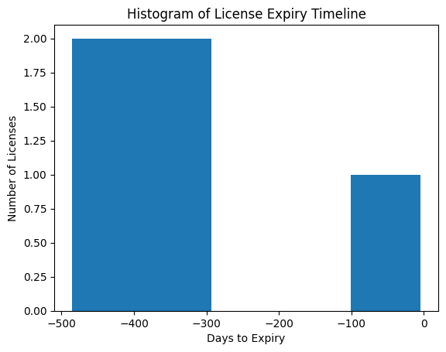
Data Visualization

Slide 12
Histogram – License Expiry Distribution
6.2.1 Description:
The histogram displays the distribution of licenses based on the number of days remaining until expiry.
Analytical Insight:
Clusters on the lower end indicate high renewal risk
Wider spread indicates well-distributed renewal timelines
Helps compliance teams plan renewals in advance
Business Value:
Prevents sudden license lapses
Enables workload planning for renewals
Supports early-warning compliance systems

Slide 13
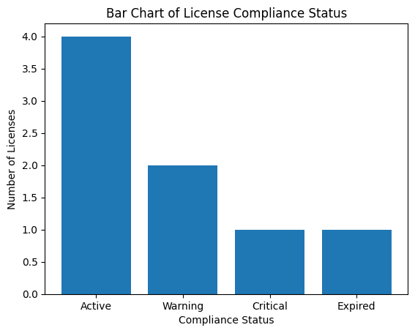
Data Visualization

Slide 14
Bar Chart – Compliance Status Summary
Description:
The bar chart summarizes the total number of licenses under each compliance category (Active, Warning, Critical, Expired).
Analytical Insight:
Higher “Warning” or “Critical” bars indicate growing compliance pressure
Useful for month-on-month compliance comparisons
Business Value:
Simplifies compliance reporting
Helps management assess overall regulatory health
Enables KPI tracking for compliance teams

Slide 15
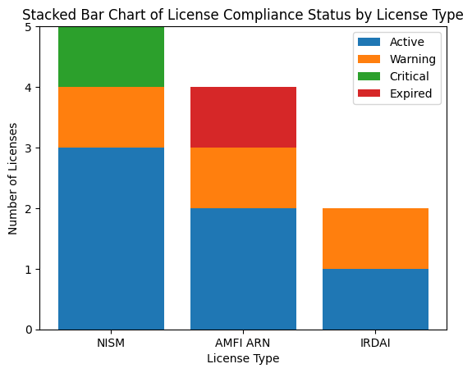
Data Visualization

Slide 16
Stacked Bar Chart – Compliance by License Type
Description:
This chart shows license compliance status segmented by license type (e.g., NISM, AMFI ARN).
Analytical Insight:
Identifies which license types are more prone to expiry
Highlights regulatory areas needing focused attention
Business Value:
Targeted training and renewal initiatives
Better allocation of compliance resources

Slide 17
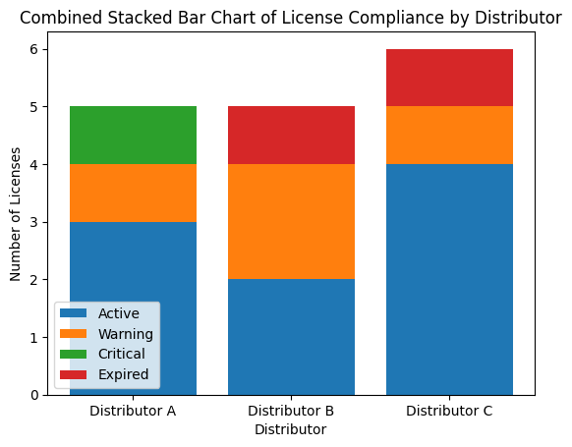
Combined Stacked Bar Chart – Compliance by Distributor

Slide 18
Combined Stacked Bar Chart – Compliance by Distributor
Description:
The combined stacked bar chart compares multiple distributors, with each bar representing total licenses and stacked by compliance status.
Analytical Insight:
Distributors with larger “Expired” or “Critical” segments pose higher risk
Side-by-side comparison enables benchmarking
Business Value:
Supports distributor performance evaluation
Enables risk-based compliance intervention
Ideal for management dashboards and audits

Slide 19
Analytics Interpretation
From the visual analysis:
Proactive distributors maintain higher proportions of active licenses
Renewal delays are clearly visible through warning and expired segments
Visual analytics significantly improve compliance monitoring efficiency
The combination of multiple charts provides both micro-level insights (individual license risk) and macro-level insights (overall compliance health).

Slide 20
Decision Support Enabled by Analytics
The visualization framework supports:
Renewal prioritization
Compliance risk assessment
Distributor benchmarking
Regulatory reporting
Strategic planning for license management

Slide 21
Conclusion
Visualization and analytics form the backbone of the Distribution License Tracker. By converting license data into intuitive charts, the system enables faster decision-making, reduces compliance risk, and ensures uninterrupted business operations. The analytical approach demonstrated in this project closely aligns with real-world compliance management practices in the financial services industry.

